Slide 1
Early Alert GR2 Analyst Installation Guide
Shae McLamb - April 2021

Slide 2
About GR2 Analyst
GR2 Analyst is a desktop-based radar software program that displays a variety of NEXRAD Level II products.
GR2 Analyst has a variety of different features that are useful for daily Early Alert operations:
Standard and Super Resolution Level II data
Dual Polarization data
High resolution derived products (e.g. Echo Tops, MEHS, etc.)
Cross-Sections
Volumetric Display
Live or archived L2 data
Severe weather warnings
Local Storm Reports (LSRs)
Ultra-high resolution background imagery
Early Alert has a business license for GR2 Analyst. It is strongly encouraged that MetTeam members are familiar with the software as it is used during severe weather outbreaks.
Since GR2 Analyst does not have a mobile feature, RadarScope is the recommended radar app for smartphones.

Slide 3
Installing GR2 Analyst
Navigate to the GR2 Analyst Webpage (http://www.grlevelx.com/gr2analyst_2/)
Scroll down to the download link.and click “GR2Analyst_2_Setup”
Note the following system requirements. Company computers should have no issue running the software.

Slide 4
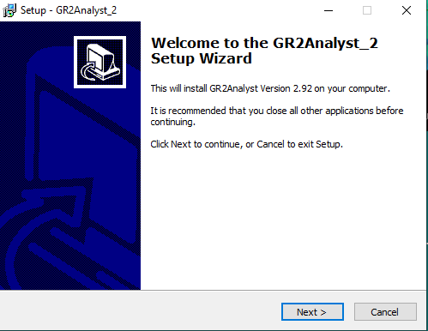
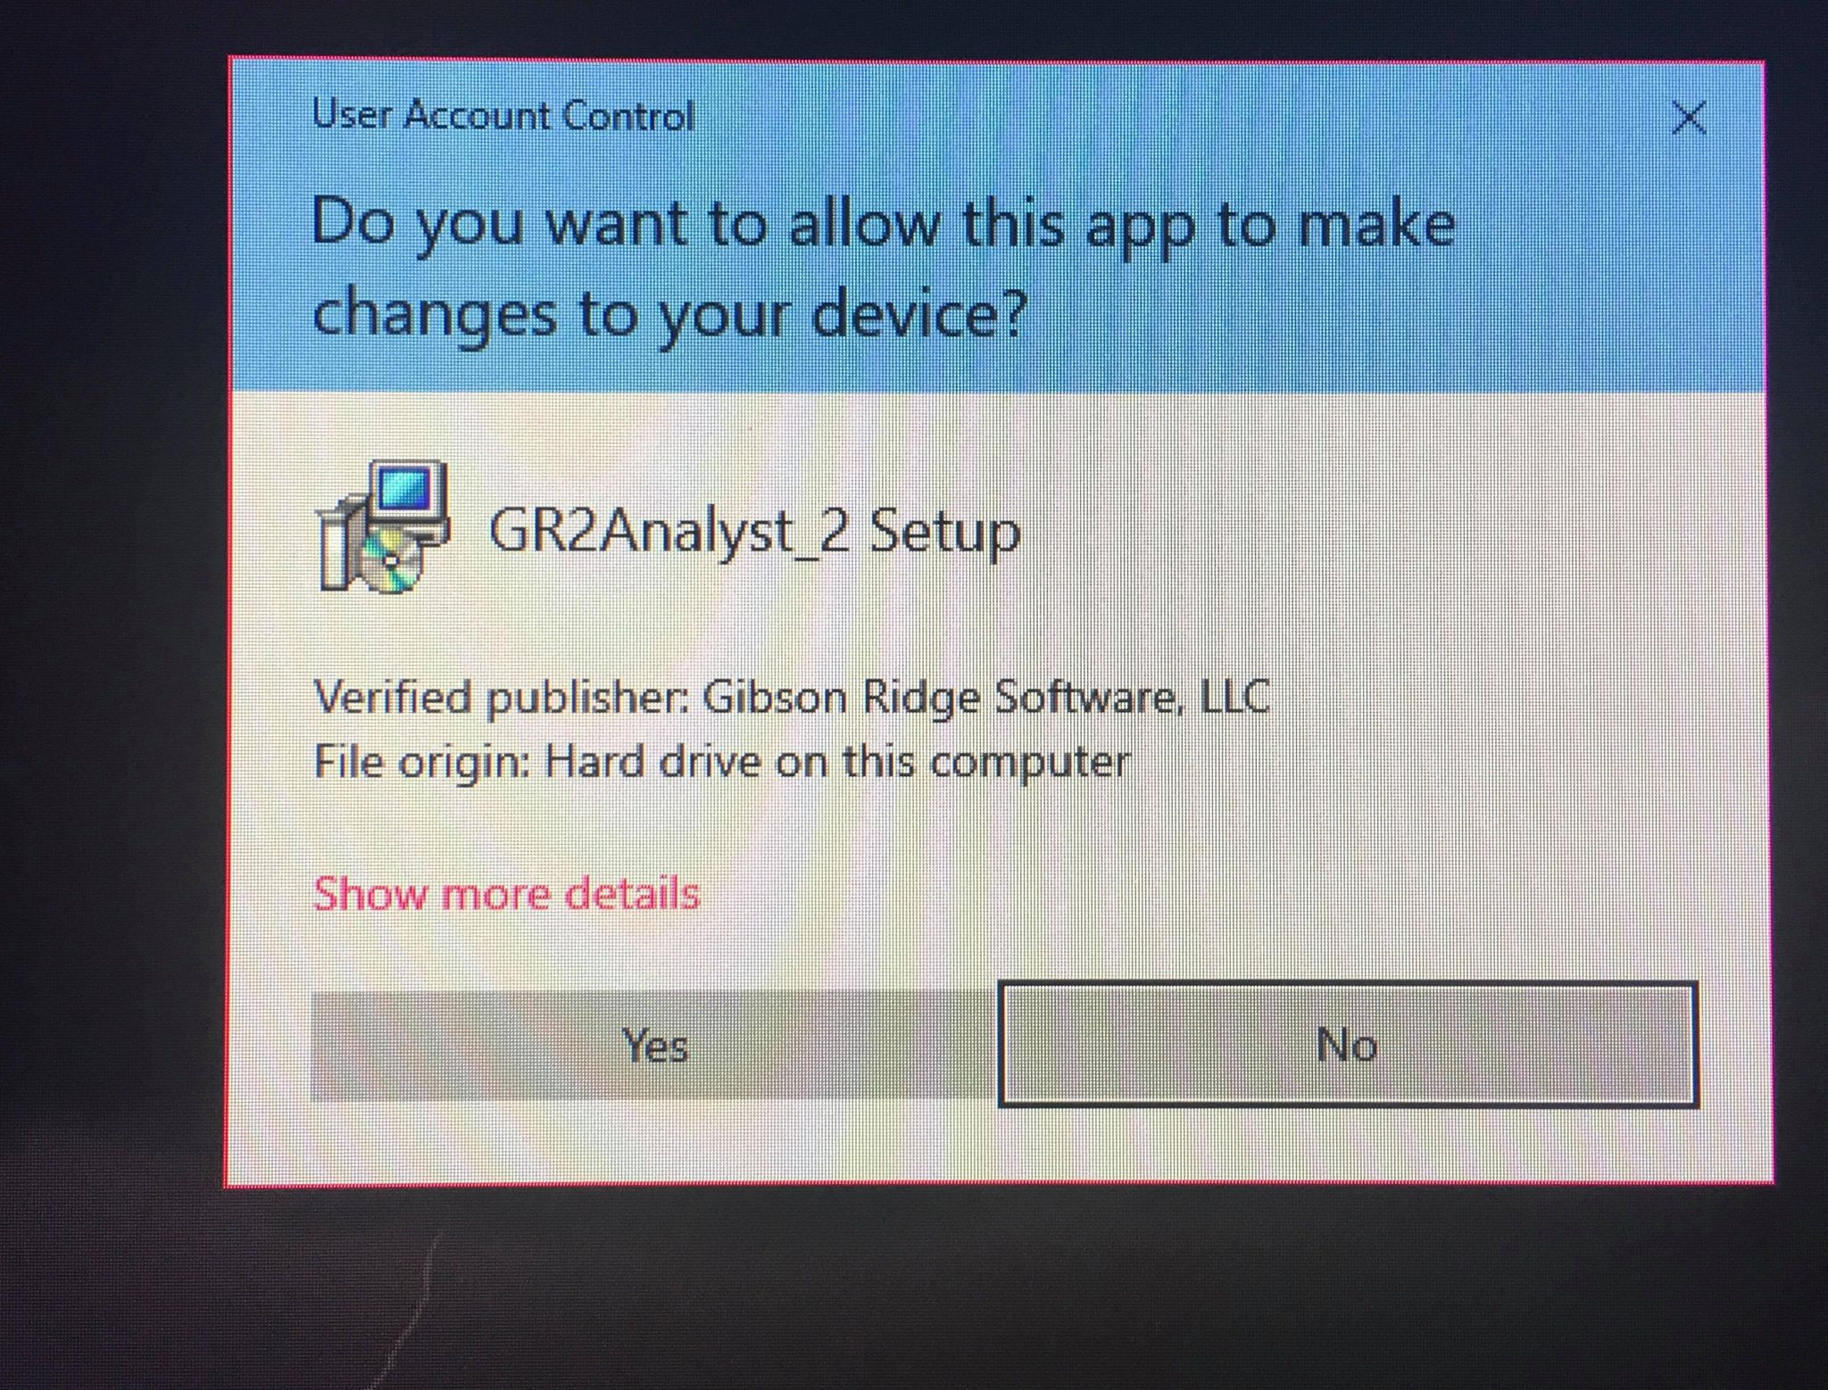
Installing GR2 Analyst (..cont.)
Once the download link is clicked, it will prompt a download of an .exe file. When download is completed, open the .exe file.
Click yes and follow the setup wizard.

Slide 5
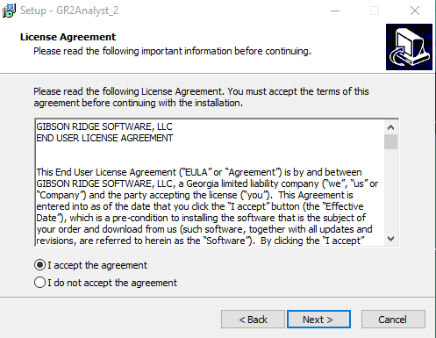
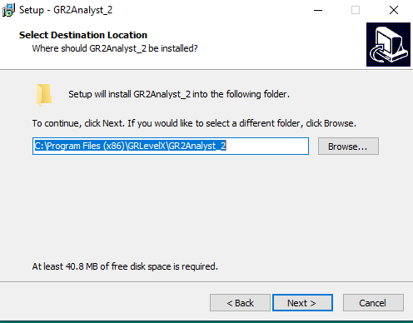
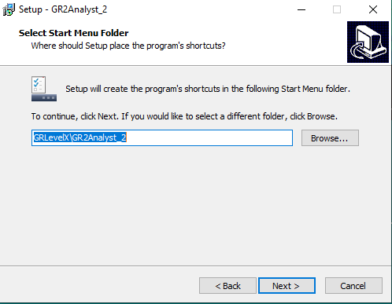
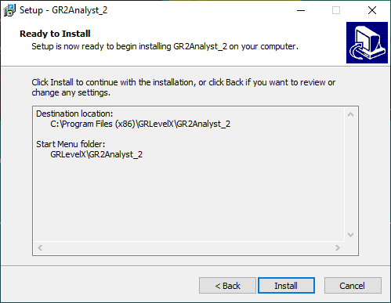
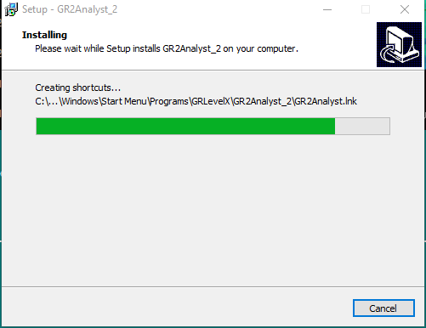
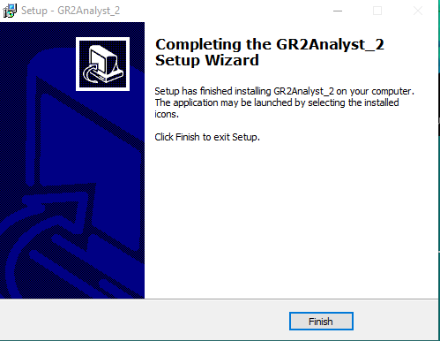
GR2 Analyst Install Wizard

Slide 6
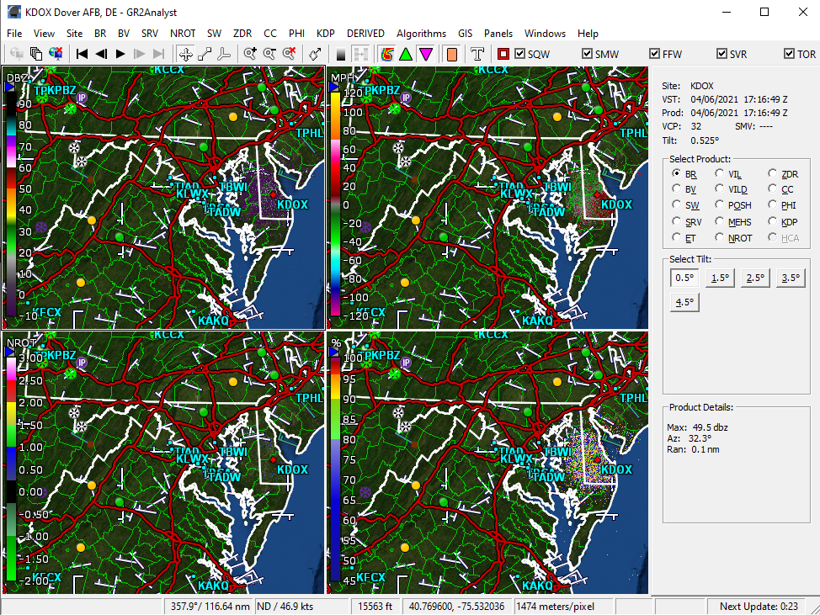
Current Radar Site
Zoom
Storm Motion Vector
Show radar data, hail est., TVS, LSRs, P-Type, Marker
Show Warnings
Radar products
Smoothing/Dealias
Polling tools
Current Radar Site
Radar Loop
NEXRAD Product
Cross-section tools
Radar Scan Angle Tilt
Radar Sites (active RED dot)
Radar Scan Details
Time until next update
Measurements/Lat-Lon

Slide 7
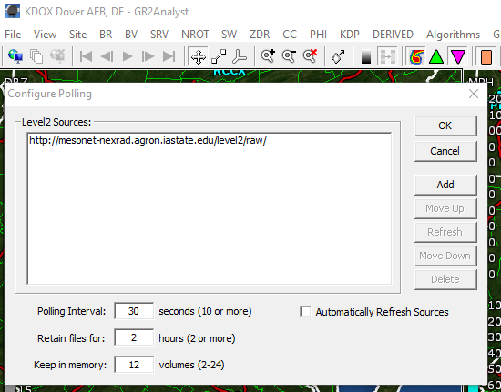
GR2Analyst Initial Setup – Data Feed
Following the GR2Analyst install, open the application and begin the setup process.
You will be prompted to select a data feed. If you do not have the option to select a default, manually enter the Iowa State feed:
http://mesonet-nexrad.agron.iastate.edu/level2/raw/
This can be modified later by stopping polling, going into File > Configure Polling.
Resume polling by clicking the resume button.
Resume Polling
Stop Polling

Slide 8
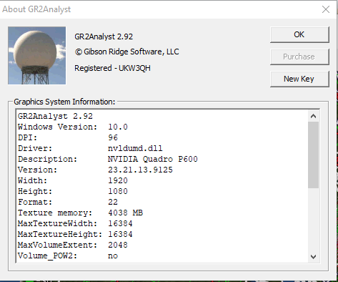
Early Alert License Key Submission
Early Alert Key can be found here (EA login required) - use the New Key.
In GR2 Analyst, go to Help > About > and click on the option to enter the product key (if you are updating, it may show as “New Key”). This is not required if your GR2 is already registered.
This window also shows the current version of GR2 Analyst. Users in April 2021 should have the latest version 2.92 (which includes terminal radar data).

Slide 9
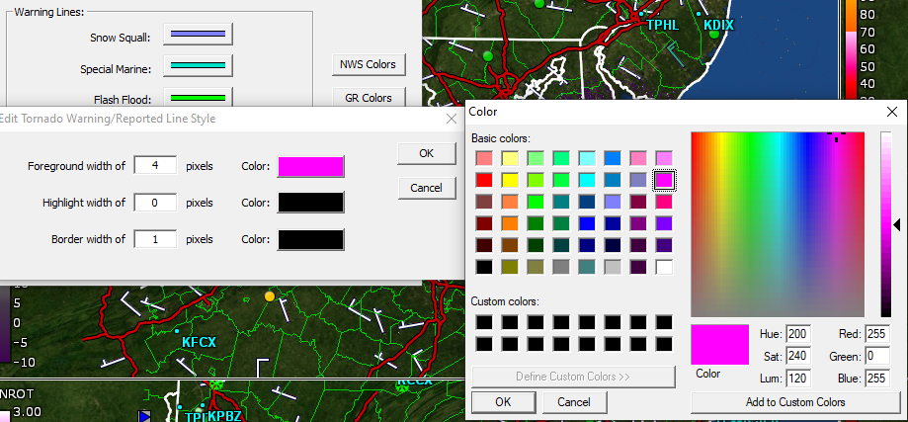
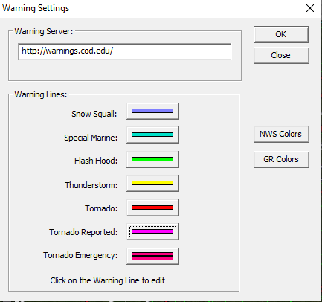
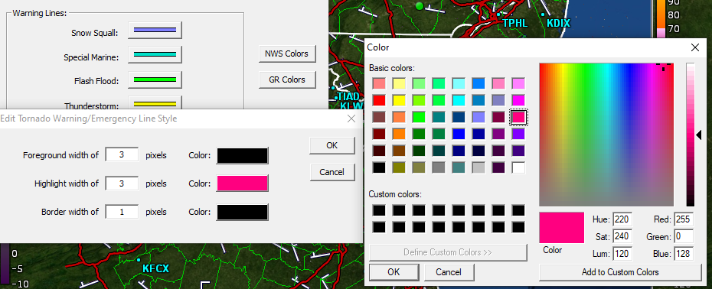
Warning Color Settings
Access Warning settings by clicking View > Warning Settings.
Default used by Early Alert MetTeam:

Slide 10
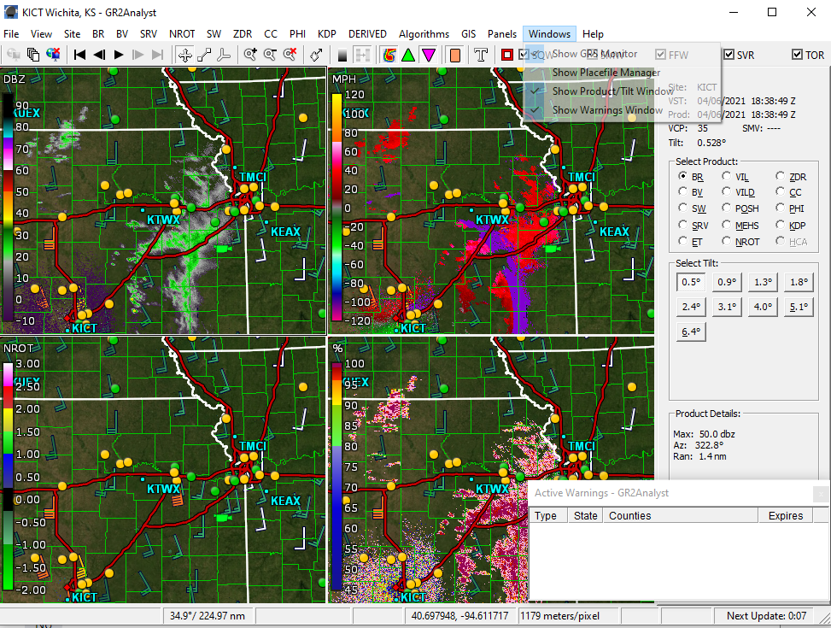
Active Warnings Window
Recommended to have visible during operations. Will show the same colors as applied in the Warning Settings.
To show the Active Warnings Window, click Windows > Show Warnings Window.
The warning text can be viewed by clicking the warning polygon OR right-clicking the warning listed in the Active Warnings Window.

Slide 11
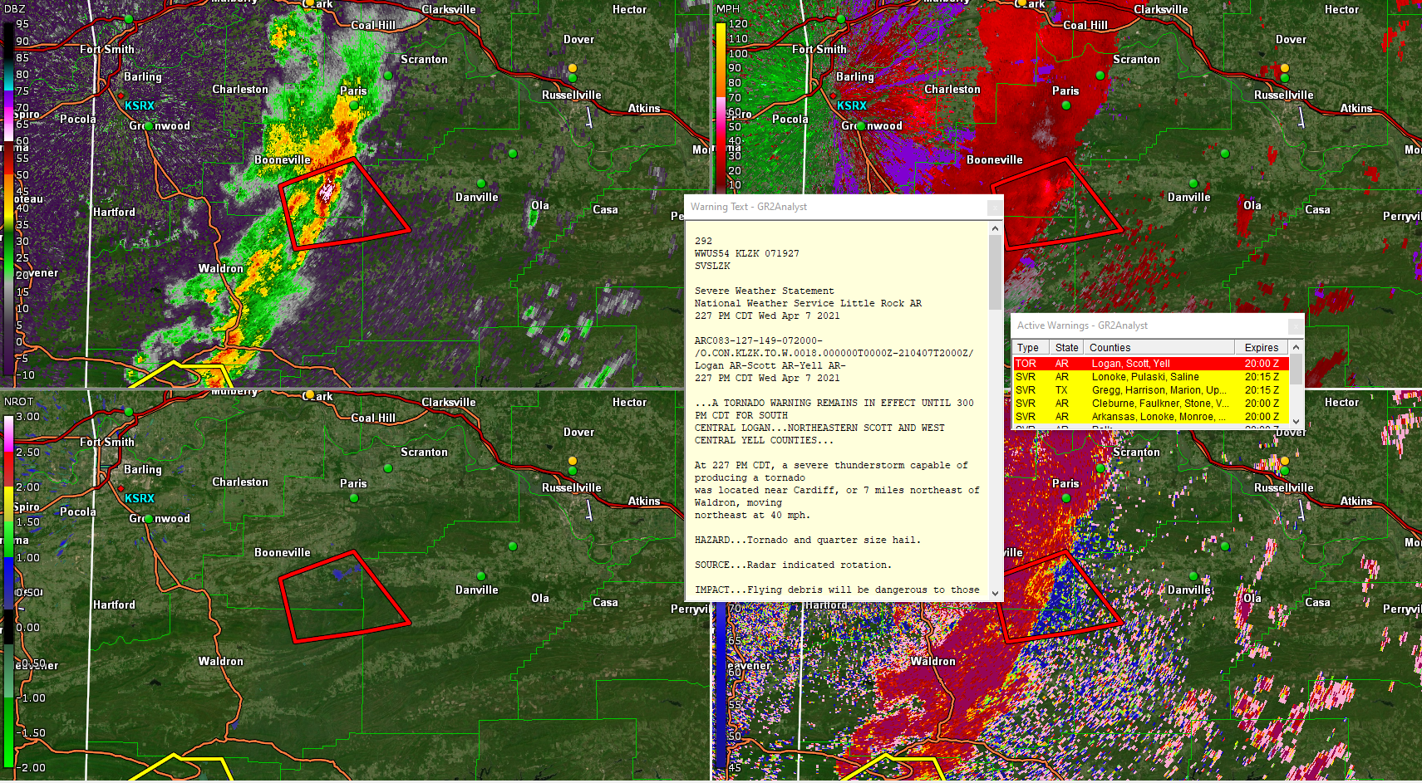
Active Warnings Window
The warning text can be viewed by clicking the warning polygon OR right-clicking the warning listed in the Active Warnings Window.
Double-clicking the warning in the Active Warnings window will change the radar site to one closest to that warning.

Slide 12
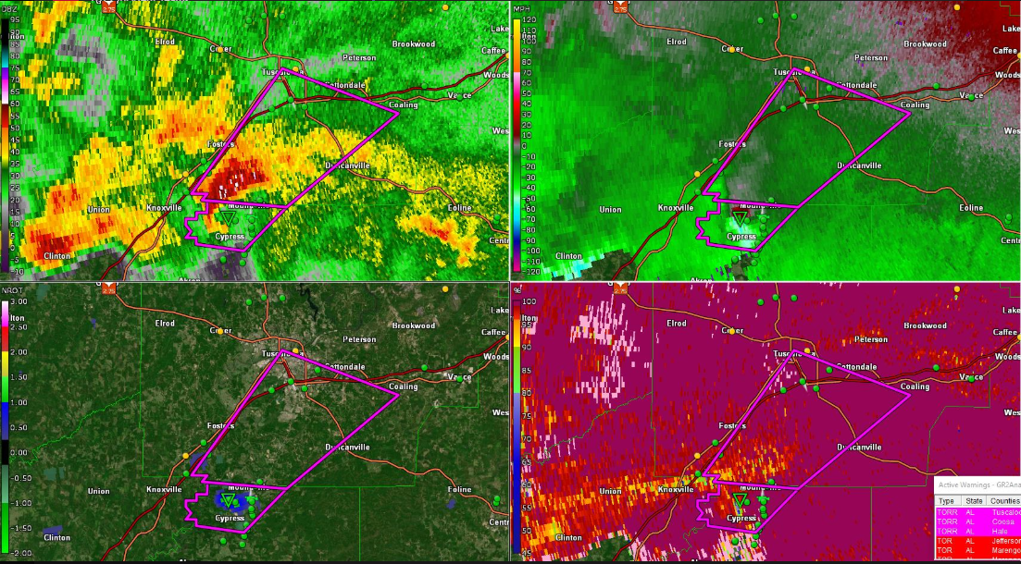
Four-Panel View
For severe weather monitoring, base-tilt (lowest available degree angle) of the four following panels are default.
Base Velocity (BV)
Base Reflectivity (BR)
Normalized Rotation (NROT)
Correlation Coefficient (CC)

Slide 13
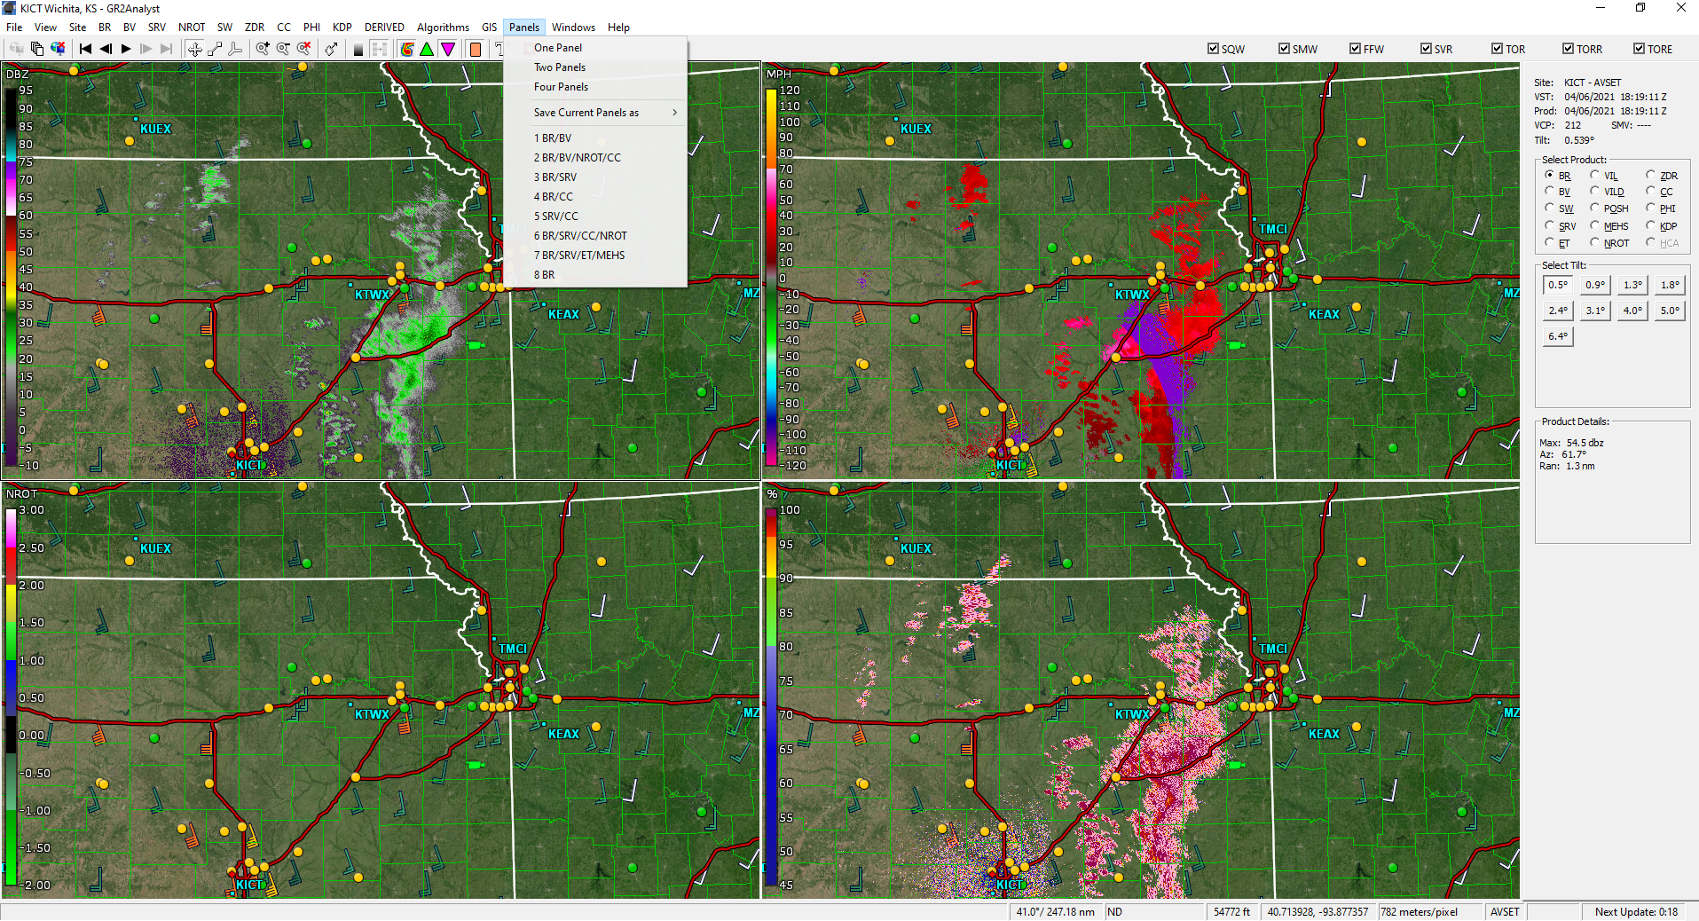
Setting Panel Views
To set different panel views, Go to Panels and select the number of panels from the drop-down menu. Then use the product selector on the side after clicking each window to set the product.
If you get a panel configuration you like, you can save as a favorite by going back into the panel tab and clicking Save Current Panel As.

Slide 14
Editing Color Tables
Color Tables can be modified to help emphasize small features that may be of importance.
Changing Color Tables in GR Programs:
http://www.grlevelx.com/manuals/color_tables/index.htm

Slide 15
Modified Color Table Files
There are a few modified color table files being utilized by the team:
It is recommended to at least modify the Base Reflectivity (BR) and Base Velocity (BV) color tables using these files.
For additional modifications, Michael Mugrage (former EA Intern, now at NWS Mobile) developed a series of modified color tables that can be found here.
Simply download the desired files/folders and follow the instructions on the previous slide.

Slide 16
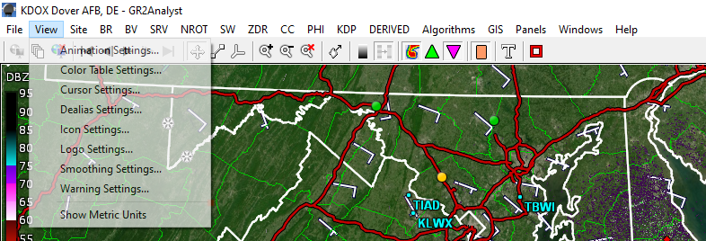
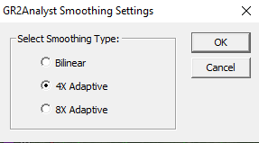
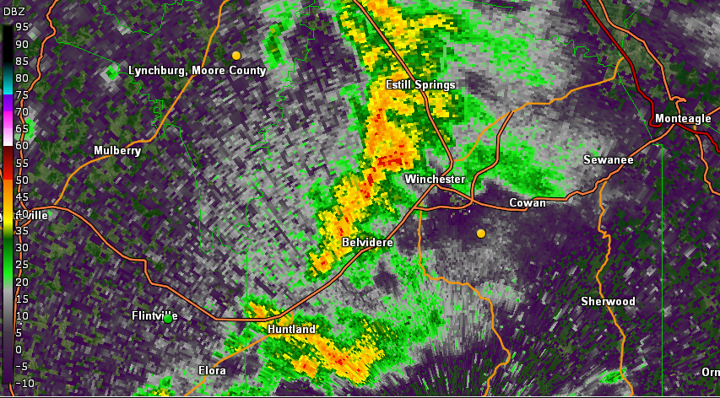
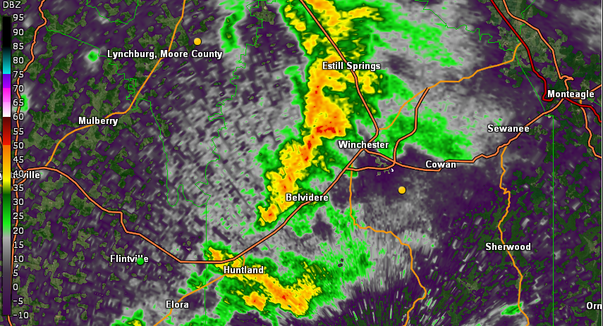
Smoothing
CAUTION: smoothing may remove small key features of importance.
If smoothing is desired, it can be toggled on/off from the main toolbar.
To adjust the smoothing settings, click View > Smoothing Settings
4X Adaptive is the default for GR2 Analyst
Smoothing Settings
Smoothing Toggle
Smoothing OFF
Smoothing ON

Slide 17
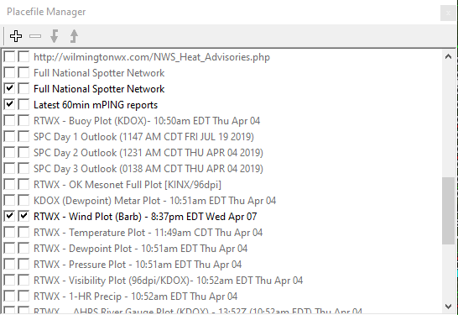
Using Placefiles
Placefiles are overlays that can be added to GR2 Analyst.
To open the Placefile Manager, click Windows > Show Placefile Manager.
The checkboxes toggle visibility and can be ordered to allow layering using the arrows.
Although GR2 Analyst will show some LSRs, adding additional sources for storm reports can be extremely beneficial during severe weather (Spotter Network) and winter weather (mPING).
Station plots, NWS outlooks, and numerous other products can be added to your “Placefile library”.

Slide 18
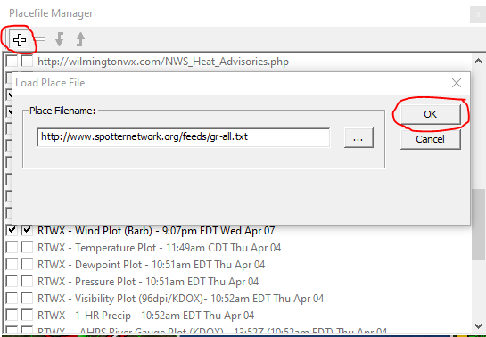
Adding Placefiles
In the Placefile manager, click the + button, paste in the link of the desired addition, and click ok. Then follow the toggle instructions (prev. slide) as needed.
Placefiles for GR2 Analyst can be found via a google search. There are numerous sources to build your own library from
mPING Placefile: http://gr.wxjoe.com/ping-60min.txt Spotter Network Placefile: http://www.spotternetwork.org/feeds/gr-all-no.txt
Wind Plots (Barb) w/ Station Observation hover box: http://placefiles.redteamwx.com/wind.php

Slide 19
Placefiles Sources – Build YOUR library!
https://placefilenation.com/
http://www.redteamwx.com/grlevelx.html
https://mesonet.agron.iastate.edu/request/grx/
https://luker.org/resources/grlevelx/placefiles/
https://www.oswego.edu/~osscams/placefiles
https://grlevelxusers.com/grlevelx-goodies/?view=category&sort=post_modified
https://www.w5djt.com/index.php/all-things-grlevelx
Placefiles for GR2 Analyst can be found via a google search. There are numerous FREE sources to build your own library from!

Slide 20
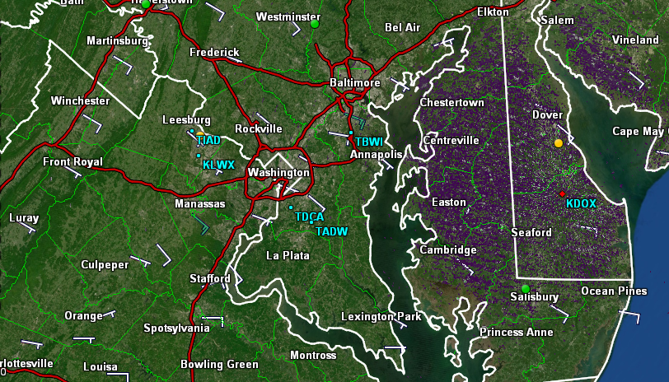
NOAA Radar Sites vs. Terminal Radars
With version 2.92, GR2 Analyst now shows terminal (aviation) radar in addition to the normal NWS Radar sites. This can be extremely beneficial in areas with poor radar coverage.
Terminal radars are a different band type, cover a smaller area, and may have fewer radar products available. However, most have reliable base reflectivity and base velocity feeds that are useful during severe weather.
Terminal radars are denoted with a T while NWS radars are denoted with a K
BWI Airport, MD (terminal): TBWI
Sterling, VA (NWS): KLWX

Slide 21
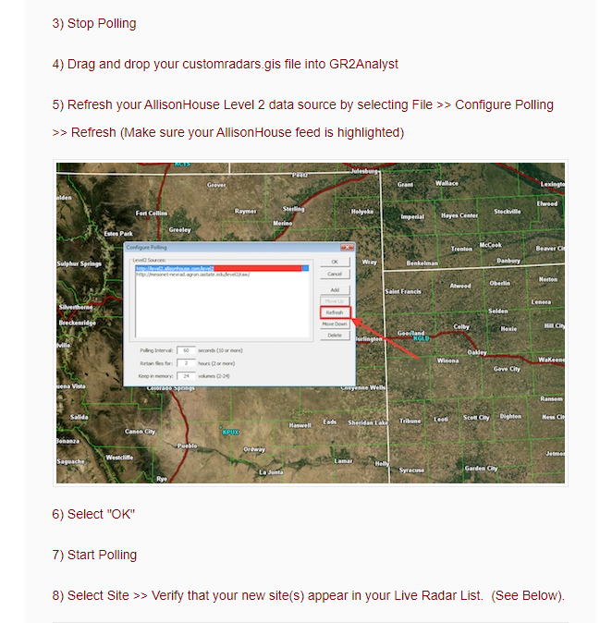
Adding Specialized Radar Sites
There are a few test radar sites (usually university owned) that can be added to GR2 Analyst. One of these radars is KULM in Monroe, LA.
Follow the instructions provided here. This will work with the IA State Data Feed:
https://support.allisonhouse.com/hc/en-us/articles/206870453-Adding-Custom-Radars-GRLevel2AE-
The .gis file can be downloaded from SharePoint here.

Slide 22
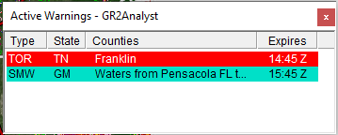
Warning Product Glossary
The number next to the warning abbreviations in the toolbar notes how many of those warning type are currently in effect.
SQW: Snow Squall Warning
SMW: Special Marine Warning
FFW: Flash Flood Warning
SVR: Severe Thunderstorm Warning
TOR: Tornado Warning (radar-indicated)
TORR: Confirmed Tornado Warning (either radar-confirmed or observed)
TORE: Tornado Emergency (high-impact from an ongoing tornado likely)

Slide 23
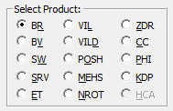
Radar Products Glossary RED text denotes commonly used
Base Reflectivity (BR): Echo intensity; used to detect precipitation, evaluate storm structure, locate boundaries, and determine hail potential
Base Velocity (BV): Measures the wind relative to its direction towards (negative-GREEN) or away (positive-RED) from the radar. Used to estimate wind speed/direction, locate boundaries, denote severe weather signatures (rotation/straight-line winds/downbursts), and identify areas of turbulence.
Spectrum Width (SW): Measures the velocity dispersion within the radar sample volume. Used to estimate turbulence with mesocyclones and boundaries.
Storm Relative Velocity (SRV): Subtracts the storm motion from base velocity. Used to identify severe weather signatures within a storm.
Echo Tops (ET): Identifies the height of an echo. Used to estimate most intense convection, identify storm structure features, and important for aviation forecasts.
Vertical Integrated Liquid (VIL): Measures the water content in a column of air. Used to indicate hail, note most significant storms, and identify heavy rainfall.
Vertical Integrated Liquid Density (VILD): Compares water content relative to the height of the echo. Used to identify heavy rainfall and presence of hail cores.
Probability of Severe Hail (POSH): Algorithm used to determine the likelihood of the presence of hail exceeding .75 inches in diameter.
Maximum Expected Hail Size (MEHS): Algorithm used to estimate the largest size of hail produced by a thunderstorm.
Normalized Rotation (NROT): Azimuthal shear normalized by area. Useful to determine areas of rotation within a thunderstorm.
Differential Reflectivity (ZDR): Measures the difference of the radar return in the vertical & horizontal plane. Used to distinguish precipitation size and presence of hail.
Correlation Coefficient (CC): Measures the similarity of targets in a column. Used to detect tornado debris and identify mixed winter precipitation
Differential Phase Shift (PHI): Measure in the difference of attenuation in the horizontal and vertical plane. Used to determine the shape and concentration of precipitation.
Specific Differential Phase (KDP): Measures the difference of the radar return changes in the vertical & horizontal plane. Used to detect heavy rain and presence of hail.
Hydrometeor Classification Algorithm (HCA): Determines the most likely classification of precipitation based on radar returns. Useful for winter weather.
https://www.weather.gov/jan/dualpolupgrade-products#:~:text=Definition%3A%20Differential%20Phase%20Shift%20(%CE%A6DP,each%20pulse's%20phase%20to%20change.
https://www.ncdc.noaa.gov/data-access/radar-data/nexrad-products
http://www.grlevelx.com/manuals/grlevel3_2/radar_products.htm

Slide 24
Additional GR2 Analyst Tutorials
For those involved with severe weather operations, especially members of the MetTeam, it is important to familiarize yourself with GR2 Analyst.
The Gibson Ridge 2 Analyst Program for Dummies Powerpoint developed by Kevin Skow of NWS Topeka is an EXCELLENT resource:
https://www.weather.gov/media/top/GR%20for%20Dummies%202.70.pdf
GR2 Analyst Manual: http://www.grlevelx.com/manuals/gr2analyst_2/

